Slide 1
INTENRNSHIP project presentation
Rishikesh S Panicker,
Intern, analytics services,
Tata iQ

Slide 2
overview
A week by week summarisation of my journey as an intern at Tata iQ
Week 1-2 – Refreshed concepts on python libraries such as numpy, pandas and opencv
Week 2-4 – learnt how to use labelimg and annotated images for various clients such as Tatacom, JUSCO and other image data for fire and smoke detection
Week 4-6 – worked on a deep Convolutional Generative Adversarial Network

Slide 3
Deep convolutional GENERATIVE ADVERSARIAL NETWORK – an introduction
WHAT?
A GAN, or Generative Adversarial Network, is a class of machine learning models used for generating data, particularly in the realm of image, video, and text generation. GANs were introduced by Ian Goodfellow and his colleagues in 2014 and have since gained widespread popularity and applications in various fields.
Generator: The generator's primary function is to create data that is similar to a given dataset. It takes random noise as input and produces data samples (e.g., images) that ideally resemble real data examples. Initially, the generated data is typically random and of low quality.
Discriminator: The discriminator, often referred to as the critic, is responsible for distinguishing between real data and data generated by the generator. It takes both real data and generated data as input and produces a probability score that indicates how likely the input data is real.

Slide 4
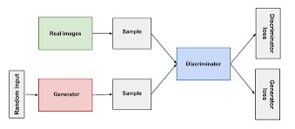
GAN ARCHITECTURE

Slide 5
Deep convolutional GENERATIVE ADVERSARIAL NETWORK – applications
Applications of GAN:
Image Generation: GANs can generate high-resolution images, artwork, and even photorealistic faces that are not distinguishable from real photographs.
Data Augmentation: GANs can be used to create synthetic data for training machine learning models when real data is limited.
Style Transfer: GANs can change the style or appearance of images, such as converting photos into the style of famous painters.
Super-Resolution: GANs can enhance the resolution and quality of images.
Image-to-Image Translation: GANs can convert images from one domain to another, like turning sketches into color images.
Text-to-Image Synthesis: GANs can generate images based on textual descriptions.

Slide 6
Deep convolutional GENERATIVE ADVERSARIAL NETWORK – training
Generator Training: The generator tries to improve by producing data that is increasingly more similar to real data. It aims to generate data that the discriminator cannot easily distinguish from real data.
Discriminator Training: The discriminator aims to become better at distinguishing between real and generated data. It learns to assign higher probability scores to real data and lower scores to generated data.
The two networks are trained simultaneously through a back-and-forth process. As training progresses, the generator becomes better at generating data, while the discriminator becomes more skilled at telling real from fake data. Ideally, this adversarial process reaches equilibrium, resulting in a generator capable of producing high-quality, realistic data.

Slide 7
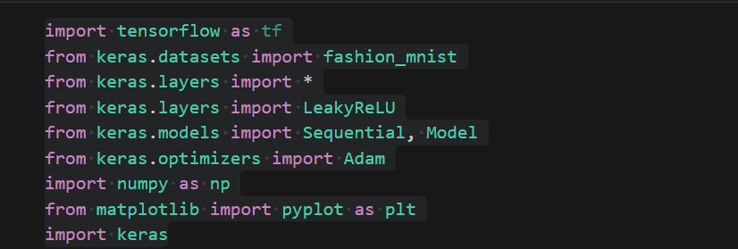
GAN – CODE IMPLEMENTATION STEP 1 (IMPORTING THE NECESSARY LIBRARIES)

Slide 8

GAN – CODE IMPLEMENTATION STEP 2 (loading the data from the dataset)

Slide 9
GAN – CODE IMPLEMENTATION STEP 3 (converting the image to a greyscale image)

Slide 10
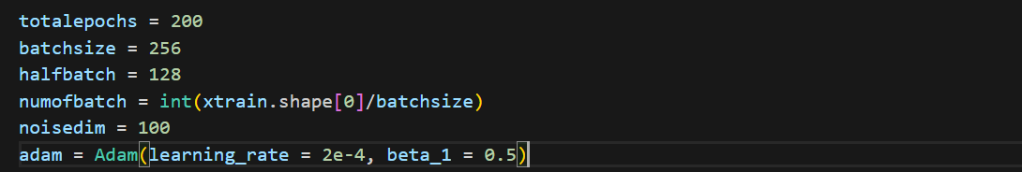
GAN – CODE IMPLEMENTATION STEP 4 (Defining training parameters)

Slide 11
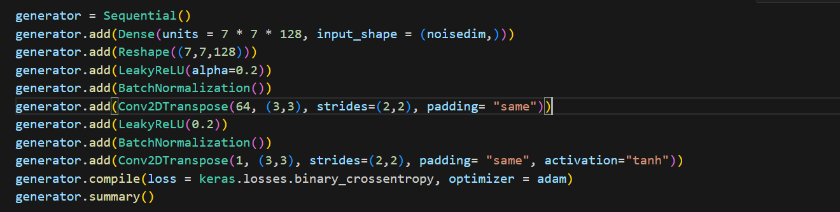
Generator model

Slide 12
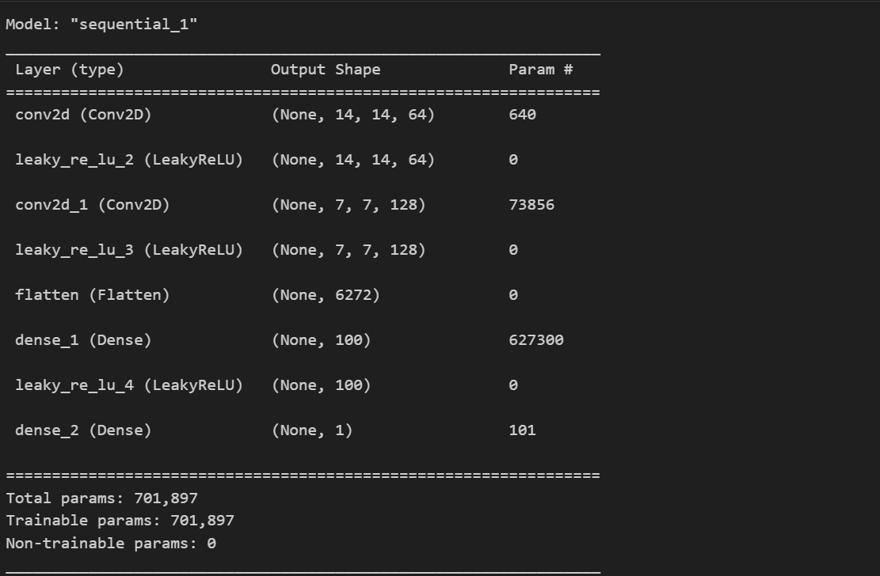
Generator model summary

Slide 13
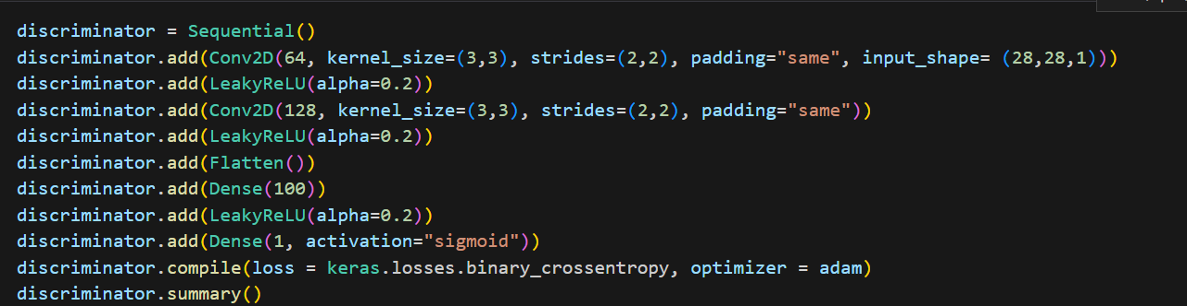
Discriminator model

Slide 14
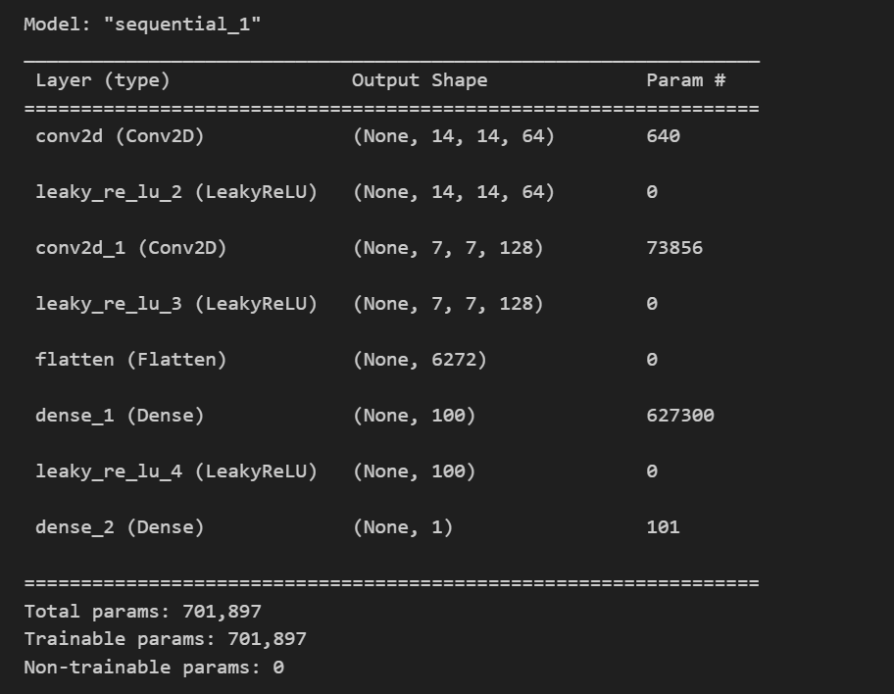
Discriminator model summary

Slide 15
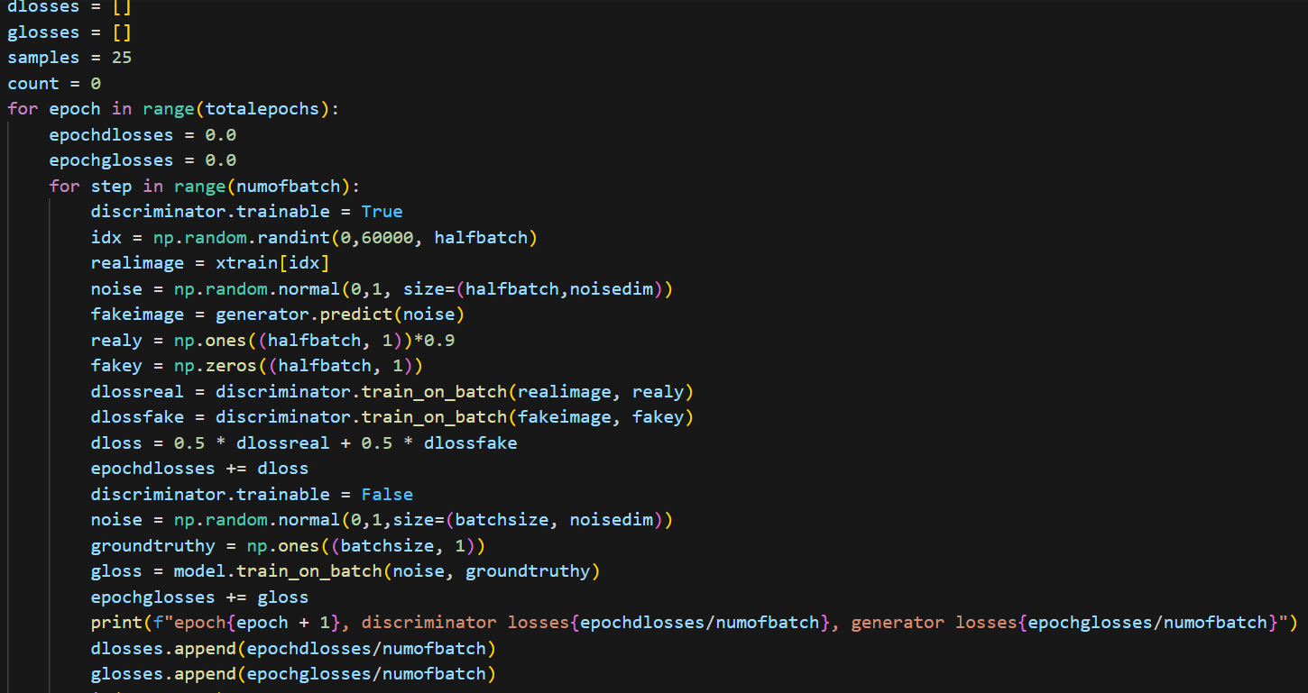
Custom training loop

Slide 16
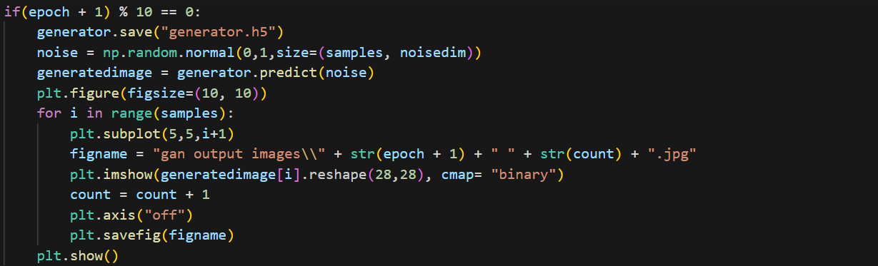
Saving the model and the outputs generated

Slide 17
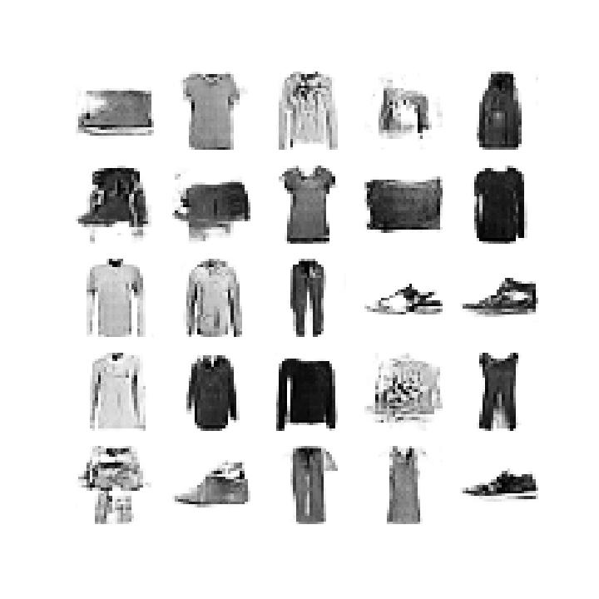
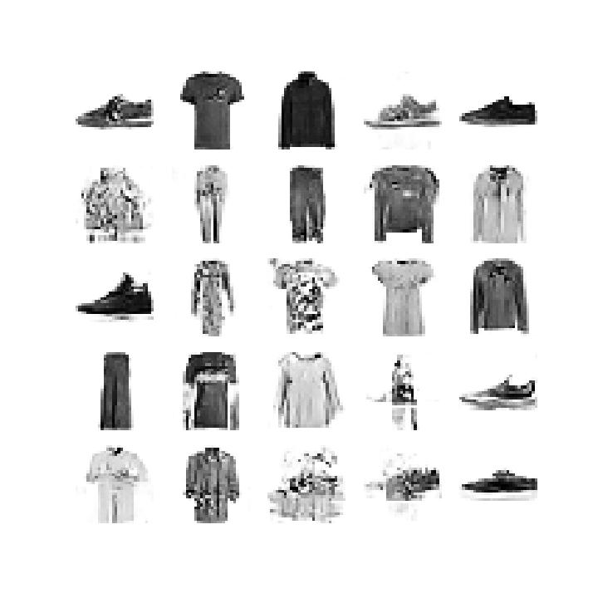
Generated images
After 50 epochs
After 100 epochs

Slide 18
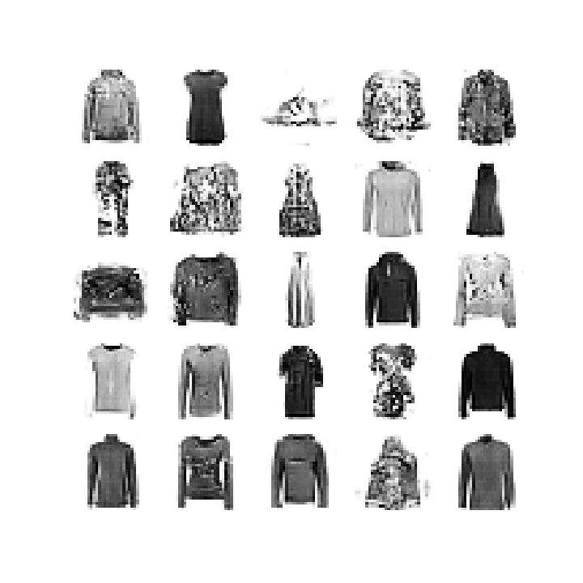
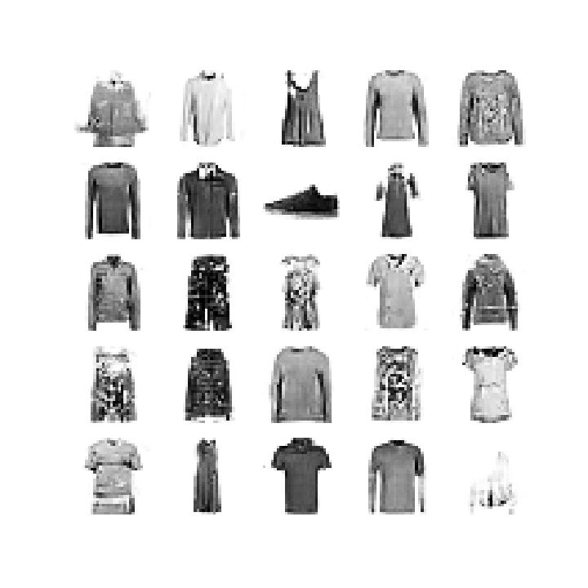
Generated images
After 150 epochs
After 200 epochs

Slide 19
THANK YOU!

